Slide 1
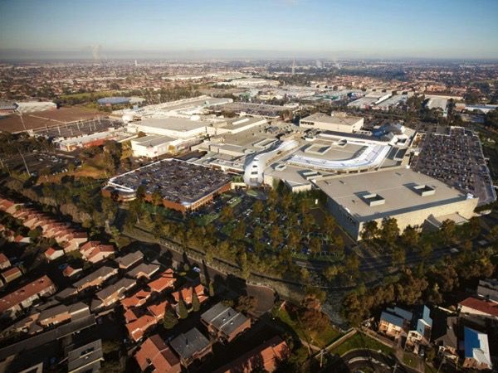
Monitoring and evaluating progress towards becoming a more adaptive and resilient region: lessons from Melbourne
Climate Compatible Development in Asian Cities Workshop 6-7th June 2016,
Asian Institute of Technology, Bangkok, Thailand.
Dr Susie Moloney,
Senior Research Fellow,
Climate Change and Resilience Program
Centre for Urban Research,
RMIT University, Melbourne.
susie.moloney@rmit.edu.au
Ms Heather McClaren
Climate Adaptation Project Officer
Western Alliance for Greenhouse Action,
City of Brimbank, Melbourne.
www.waga.com.au
HeatherM@brimbank.vic.gov.au

Slide 2
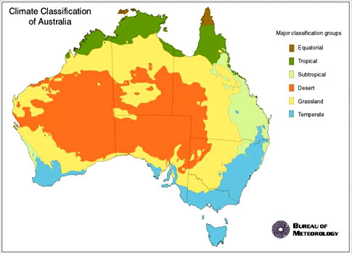
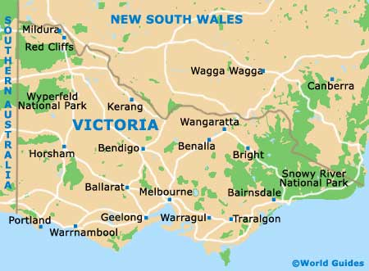
Australia – Victoria - Melbourne

Slide 3
Presentation Outline
Brief Profile of Victoria: GHG profile; emissions by sector; trends; key vulnerabilities and challenges
Climate Change Policy Profile : national, state and metropolitan initiatives
Case Study Context: WAGA western region of Melbourne; brief regional context
Case Study Project: How well are we adapting? (WAGA) How can we monitor and evaluate climate change adaptation progress in Melbourne?
Designing a Framework for Monitoring and Evaluating Climate Change Adaptation – Approaches and Indicators (Lessons from the literature and practice)
Piloting Phases: Themes and Indicators; Emerging Issues
Lessons/questions tracking progress on climate change responses

Slide 4
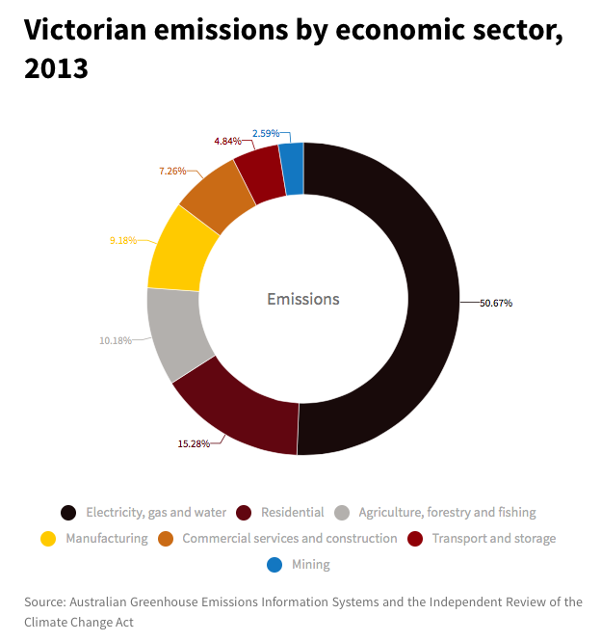
1. Brief Profile of Victoria: GHG profile; emissions by sector;
GHG profile
Victoria produces 22% (118 million tCO2-e) of Australia’s national emissions (525 million tCO2-e)
Per capita greenhouse gas emissions decreased from 24 tonnes in 1989–90 to 21 tonnes in 2010–11. However, this decrease has been offset by population growth.
Between 1989 and 2011, emissions increased by 12%.
Source: https://www.ces.vic.gov.au/soe/climate-change
Notes:
Australia has amongst the highest per capita emissions in the world.
We are the 16th largest emitter of GHG emissions in the world
We are ranked 10th in terms of per capita emissions

Slide 5
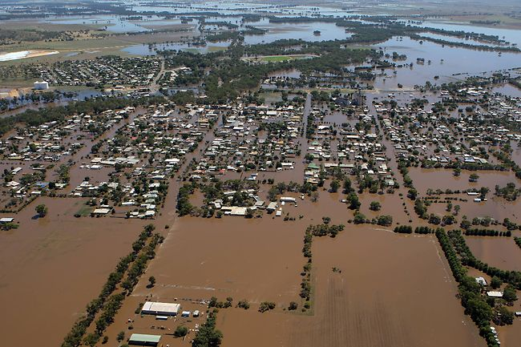
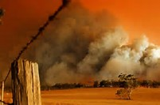
1. Brief Profile of Victoria: trends; key vulnerabilities and challenges
Trends and vulnerabilities
Average temperatures in Victoria have risen by about 0.8°C since the 1950s.
The severity, duration and frequency of heatwaves have increased.
There has been a decline in autumn, winter and spring rainfall over the past two decades.
Between 1997 and 2009, Victoria experienced a record-breaking 13-year drought and the annual inflow to Melbourne’s dams dropped by almost 40%.
Victoria experienced its highest summer rainfall on record in 2010–11, leading to major flooding that affected a third of Victoria.
Between 2000 and 2009, fires released 70 million tonnes of CO2-e, around 6% of the total emissions over the period.
Since 1993, Victoria’s sea-level rise has been similar to global averages of 3 mm per year.
Source: https://www.ces.vic.gov.au/soe/climate-change
Victorian floods 2011
Black Saturday Fires 2009

Slide 6
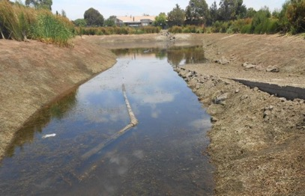
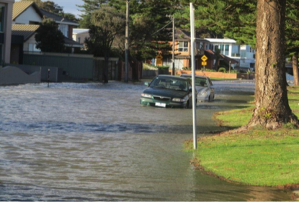
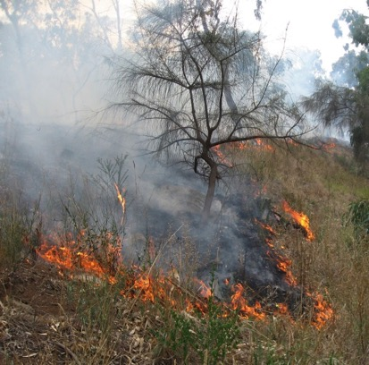
1. Brief Profile of Victoria: trends and challenges.
Projected climate trends in Victoria
By 2030 warming in Victoria is likely to range from 0.6°C to 1.2°C on 1990 temperatures and by 2070 from 0.9°C to 3.8°C.
Runoff into our waterways is projected to decrease between 5 and 45% by 2030 and between 5 and 50% by 2070.
Fire risk will increase substantially in Victoria, with the number of extreme fire danger days expected to increase by 25% by 2020 and up to 230% by 2050.
By 2070 drought frequency is likely to increase by between 10 and 80%.
More frequent extreme weather events are predicted; a current one in 100 year extreme storm surge could occur every five years by 2070.

Slide 7
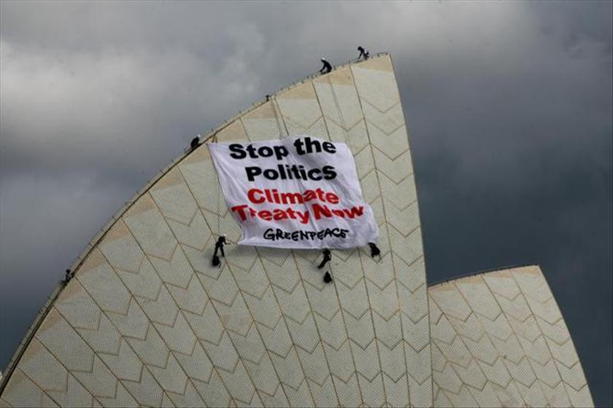
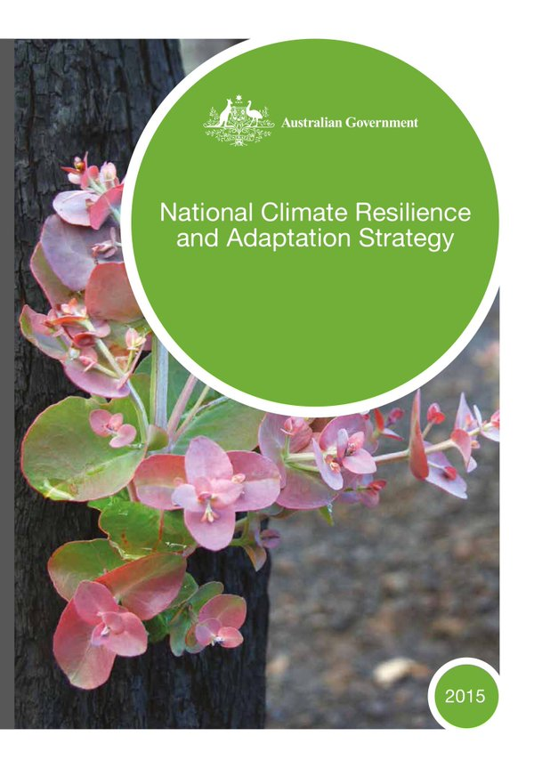
2. National Climate Change Policies and Plans:
The national target is to reduce emissions to 26-28 per cent on 2005 levels by 2030.
National level CC policy: volatile, hostile, unstable
2008-2013 Carbon Pollution Reduction Scheme, Carbon tax (Tax on major polluters)
2013- Emissions Reduction Fund (ERF) – (Pays to reduce emissions).
  * In it’s current form, the ERF provides very little support for local governments because our projects are too small in scale & do not fit the scope for the funding requirements.
National Climate Resilience and Adaptation Strategy 2015
  National support for local government adaptation is focused on providing scientific data and technical information and guidance, e.g. through CSIRO and NCCARF.

Slide 8
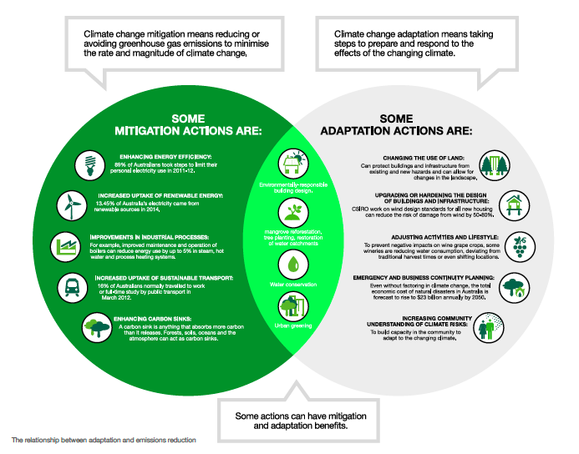
Adaptation and Mitigation Actions

Slide 9
2. State and Local Climate Change Policies and Plans: state and local initiatives.
  Existing state climate policies / initiatives includes:
Victoria has no emissions reduction target (up to 2013 target cut emissions by 20% on 2000 levels). However we have a RET of 20% by 2020 and The Victorian Energy Efficiency Target .
Reviewing all of its climate policies (i.e. Climate Change Act; CC Framework, CCA Strategy)
Metropolitan urban strategies / initiatives
Plan Melbourne Metropolitan Strategy (2016)
100 Resilient Cities (2016)
30 year infrastructure review (2016)
Local initiatives:
Almost every metropolitan (32) council has a climate action plan to reduce emissions.
A handful of metropolitan councils have adaptation policies.
Regional Climate Change Alliances: 10 Victoria; 4 metropolitan alliances
Eg. WAGA eight councils in Melbourne’s West
Notes:
*we had a target to cut emissions by 20% against 2000 levels by 2020, but this was removed in 2013 under the previous state government.
**The current state government has stated a strong desire to be leaders in responding to climate change, however we are still awaiting their policy position, which is under development, including whether they will introduce:
A strengthened emissions reduction target
A pledging process to support emission reductions.
A climate change charter
A strengthening the Climate Change Act requirements,
A Climate Change Framework,
A renewed Adaptation Plan,
***(offers low income and vulnerable households access to energy efficiency information, products and services; and provides incentives for investment and innovation in energy-efficient technologies).
****However, this requirement has been too broad, and needs to be strengthened.
*****(3 WAGA councils have policies, a further 2 are in the process of developing policies)
Range of mitigation and adaptation initiatives across councils (ad hoc)

Slide 10
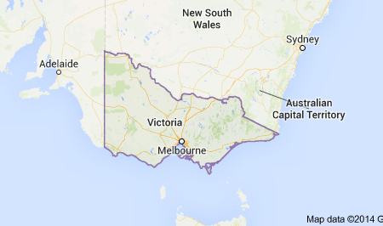
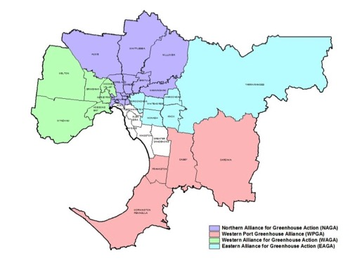
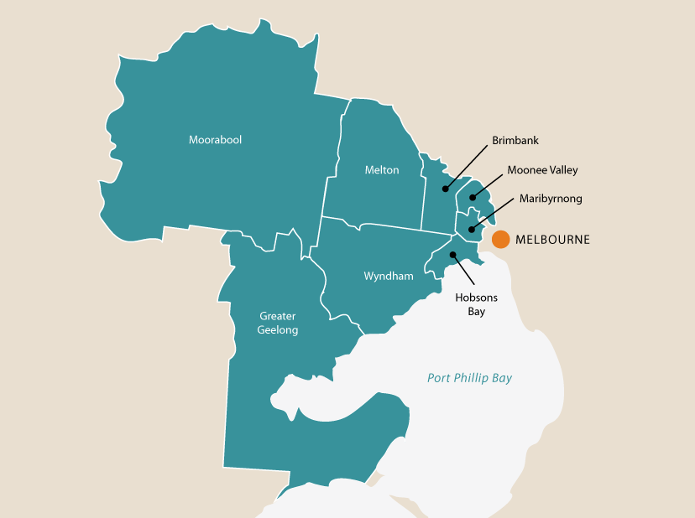
3. Case Study Project Context:
Western region of Melbourne
(WAGA – Western Alliance for Greenhouse Action – 8 councils)
Greater Melbourne: 7000+ km2
4.4mill (8 mill by 2050)
Western Region (8 LGAs): 4700 km2, Covering approx 60% of metropolitan area and 20% of population of Melbourne (4700 km2, 838,500 pop’n)

Slide 11
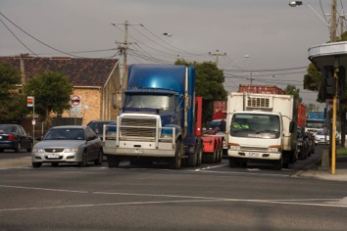
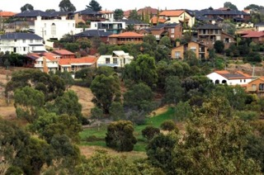
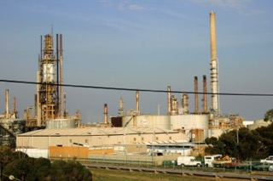
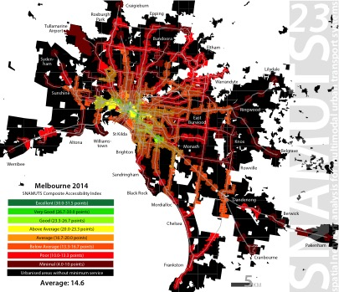
3. Case Study Project Context: Urban Development Characteristics
One of fastest growing regions in Australia, with population increasing by 20% by 2020 or 204,052 people.
Large industrial and commercial precincts and low density residential development.
A high proportion of culturally and linguistically diverse communities, with over 130 nationalities represented, including many new migrants. (source: Western Agenda, Lead West)
13% of the population was aged 65 and over at the 2011 Census (source: Lead West, Western Agenda – 2013).
Poor public transport – highly car dependent, transport corridor for heavy freight vehicles between ports, industry and suppliers.
Notes:
WAGA region: 4700 square kilometres with regional population of 838,500
Rapid population growth, low socio-demographic profile overall with a diverse range of cultures and industries
This growth is associated with significant job (31% increase) and population increases (45% increase). Similarly in Greater Geelong, a number of masterplans continue to develop, such as Armstrong Creek, the largest continuous growth area in Victoria.
Coupled with this are a number of existing industrial and commercial developments that will experience future growth, such as Essendon Fields, Airport West, East Werribee Employment Precinct, the western industrial precinct, and Living Brooklyn in Brimbank.
These developments will lead to rapid population growth, changing demographics, new housing and transport choices and a changing mix of employment, as major industrial employers and emitters wind down their operations (e.g. Toyota, Hobsons Bay). The gradual departure of major industrial employers from the WAGA region is the other major structural change that will influence the WAGA regions emissions profile and growth over the coming years.
While each council is at varying stages of CC planning – WAGA has helped develop a CC Risk Assessment, CCA Strategy, and a Low Carbon West strategy.
A major project is called How Well Are We Adapting – design and development of a Framework to M & E CCA.
Intro to Project and our role :
Project and Lessons (2014-2017)
“How Well Are We Adapting?” Developing an Monitoring and Evaluation Framework for Climate Change Adaptation.
Context:
Alliance of 8 local councils in the Western Region of Melbourne
Population ….
Literature review of M and E for Climate Change Adaptation….
Turner S, Moloney S, Glover A, and Fuenfgeld H. (2014) A Review of the Monitoring and Evaluation literature for Climate Change Adaptation, prepared for the WAGA How Well Are We Adapting?
This presentation:
Lessons from that review
Lessons from process of developing a framework and piloting it with councils

Slide 12
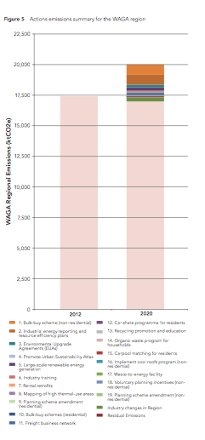
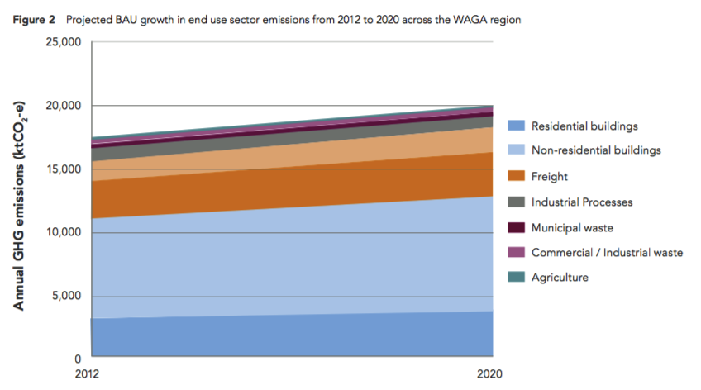
3. Brief Profile of WAGA: GHG profile; emissions by sector, trends
GHG profile
In 2012, the WAGA region produced 17.4 million tonnes of CO2-e emissions Low Carbon West: http://waga.com.au/climate-change-action/low-carbon-west/
  Approx. 3% of Australia’s total national emissions (compared to 2012 emissions http://ageis.climatechange.gov.au
  Approx. 15% of Victoria’s total emissions https://www.ces.vic.gov.au/soe/climate-change
Notes:
Emissions by sector (2012):
Non-residential buildings contribute 46% of the region’s emissions
Residential buildings (18%)
Residential transport (17%).
The waste and agriculture combined (4%).
*The sectors that are predicted to experience the highest growth in emissions by 2020 are municipal waste (21%), residential transport (20%) and residential buildings (20%). Emissions from industrial processes are anticipated to decrease by 4%.
In a highly variable national and state government policy context, eight local governments in Melbourne’s West decided that they had a role in working together to collectively reduce emissions in the region and make our region resilient to the impacts of climate change (WAGA).

Slide 13

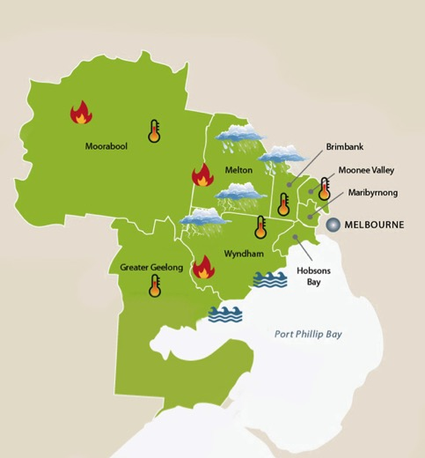

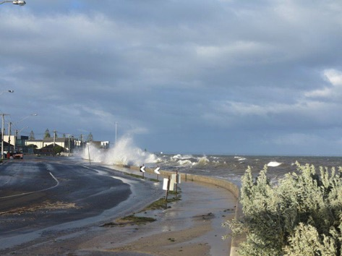
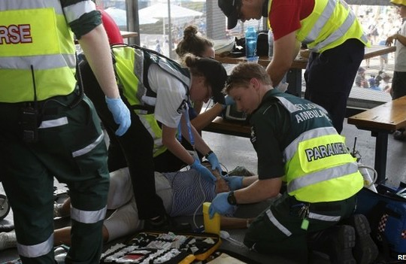
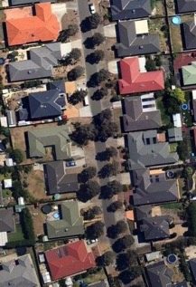

3. Brief Profile of WAGA: trends; key vulnerabilities and challenges.
Situated on the volcanic plains
An area of low rainfall, grassland habitat and limited tree canopy cover with several endangered species.
Grassfires are expected to increase in severity and frequency and coastal areas will be damaged by sea level rise.
Heat waves are becoming more frequent and severe and causing injury or death in elderly, infant, chronically ill and migrant populations.

Slide 14
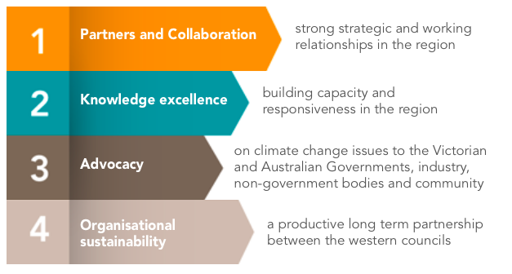
3. Western Region Climate Policies and Plans
WAGA formed in 2006. Important in leading the response….
Climate Change Adaptation Risk Assessment (2011)
Adaptation Strategy and Action Plan (2013-2020)
Low Carbon West Strategy (2014 – 2020)
Urban Sustainability Atlas* (2014 – ongoing)
Reducing councils’ own emissions – streetlight upgrades - savings of about 24,740 tonnes each year
M & E Framework : How Well are We Adapting? 2014-2017
Notes:
*a prototype interactive online map that allows users to calculate the solar radiation values of individual properties: houses and non-residential sites.
**- One important tool open to local government to assist businesses to reduce their energy use is a finance mechanism
Advocacy….

Slide 15
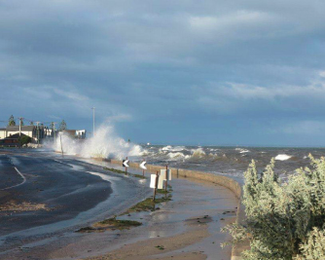
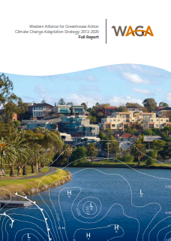
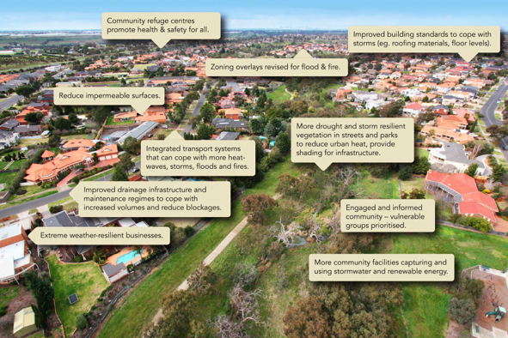
WAGA Climate Change Adaptation Strategy and Action Plan (2012):
88 risks identified (17 severe) : covering council service areas
  assets and infrastructure;
  transport;
  open space and recreation;
  natural environment;
  emergency management;
  health and community;
  planning and building;
  Business/service delivery continuity

Slide 16
4. Case Study Project: ‘How Well Are We Adapting?’ Reporting to Who and Why? Different audiences, Different objectives
Council objectives
Community objectives
Monitoring:
To inform future decision making and adaptation activities
To improve learning and build capacity
For comparative purposes
Improve awareness:
  What is happening
  What is council’s responsibility
Assure action is happening
Climate change education
The delivery of actions with concrete outcomes
Building the capacity of the council and community to respond to and manage climate impacts.

Slide 17
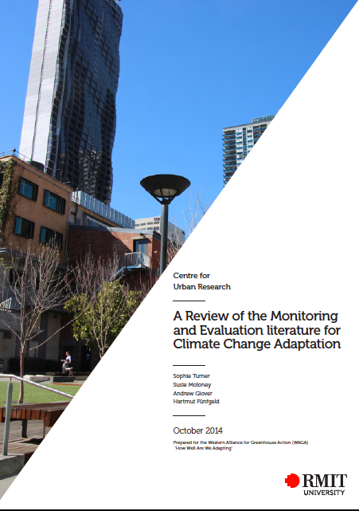
5. Designing a Framework - Approaches and Indicators:
Some key lessons from the literature
Many frameworks – few implemented
Purposes for M & E – why?
Many approaches used – process/learning
Many challenges to designing a framework – principles; shifting baselines; indicator selection/data availability; implementation and embedding
Adaptation M & E – not one size fits all; local context/issues important
https://gallery.mailchimp.com/b38874b25e686137780eb836e/files/M_E_Lit_Review.pdf

Slide 18
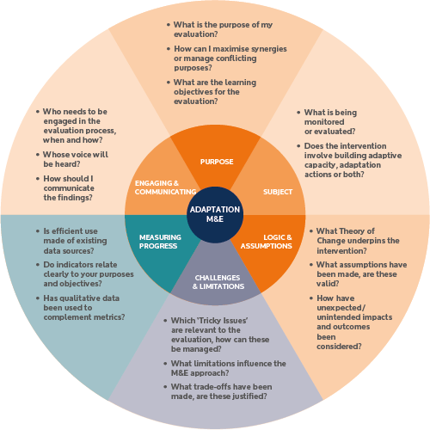

AdaptME toolkit (UKCIP 2011)
Are we doing things right?
Are we doing the right things?
Notes:
RMIT
The ADAPTME toolkit was developed by the UK Climate Impact Program UKCIP – Very useful.
Why do M & E?: To answer two key questions….Are we doing things right? Are we doing the right things?
ADAPTME is useful because it guides the user through the stops in developing an M & E process by a set of questions –
Purpose (focus for todays workshop) – will briefly go through the first four in more detail shortly…..
Subject
Logic and Assumptions
Challenges and Limitation
Measuring Progress
Engaging and Communicating

Slide 19
Purpose? Why are we doing this?
Many possible reasons…..
To evaluate effectiveness
To assess efficiency
To understand equity
To provide accountability
To assess outcomes
To improve learning
To improve future activities or interventions
To compare with other similar activities or interventions.
(AdaptME Toolkit, 2011)
Notes:
RMIT
Purpose of M & E is closely related to your objectives:
Why you do something is likely to inform what you want to achieve.
UKCIP list common reasons and state that some of these reasons may be complementary or conflicting but that understanding the synergies and tensions early on helps in developing a balanced and effective approach to M & E.
To evaluate effectiveness: this requires objectives (outputs and outcomes) are specified at the start. Still learning what is effective in CCA.
To assess efficiency: measuring costs benefits and risks and timeliness of actions (ie. Economic evaluations CBA)
To understand equity: rrelates to equity and justice and uneven impacts of CC, effects of actions of different people and their ability to engage etc
To provide accountability: contractua or procedural requirments, ensure commitments, expectations and standards are met. (may overlap with other purposes ie. Efficiency and effectiveness
To assess outcomes: this can be difficult, attribution of outcomes with interventions, timeframes etc, success can relate to avoiding negative outcomes (ie. Considered as summative evaluation)
To improve learning: core reason for doing M & E, important to think about what this means for this framework and balancing the ‘what happened and why’ (learning) question with the ‘have we done what we said we would’ (accountability) question
To improve future activities or interventions: to inform future projects or mid-way through an ongoing project(ie. Formative evalution)
To compare with other similar activities or interventions: comparing an intervention in different places or within different communities or comparing implementation and outputs of an intervention with another.

Slide 20
Methods and types of evaluation/assessment
Formative: informs decisions to improve, assess program development
Summative: assesses overall effectiveness at the end
Source: Learning to ADAPT (Villaneuva 2011, p. 20)
Notes:
RMIT
Two main types of Evaluation
Formative
A formative evaluation is used to inform decisions about improvement, to evaluate a project or program’s development and to learn about incremental changes. It is often done during the implementation of an adaptation initiative.
Summative
A summative evaluation assesses the overall effectiveness of an initiative and informs decisions about whether to continue or end a project. It is usually conducted when the adaptation initiative is complete.
Approaches to Evaluation categorised into four groups
Input-output-outcome based evaluations : most commonly used and adopt a logic model to assess effectiveness (evaluates connections between inputs, activities and outputs)
Process based evaluations: also commonly used to assess processes and key stages without specifying an end point (help improve processes)
Evaluation of behavioural change: assesses specific BC around adaptive capacity for instance at a project level (org or community)
Economic evaluations : CBA etc
Key Point: 1 and 2 are the most common approaches and are recommended for the WAGA CCA M&E Framework

Slide 21
Common Approach: Input-output-outcome

Slide 22
Less Common Approach but Important for Adaptation:
Process based evaluation
How a program is being implemented?
Define the key stages in a process that would lead to the ‘best choice of end point’ without specifying that point at the outset.
Measure and reflect on building adaptive capacity but does not define what type of outcomes will emerge.
Encourages a learning-by-doing approach. (E.g. build climate change adaptation response into policies, establish an adaptation committee etc.)
Uses quantitative and qualitative data collection and analysis methods.
The limitations of the process evaluation is that it does not evaluate outcomes.
Notes:
Example of process-based evaluation on next slide

Slide 23
Advantages
Process-based indicators | Outcome-based indicators
Allow stakeholders/sectoral experts to choose the most appropriate adaptation action to meet an outcome Flexible approach – can adjust to new information as it becomes available | • Most government policy objectives/targets are outcome-based • May be possible to link adaptation objectives with objectives in other policy areas • Likely to be sector-specific
Disadvantages
Process-based indicators | Outcome-based indicators
• Defining a process does not guarantee successful adaptation • A different approach from most other government targets, so often unfamiliar to practitioners • May make it difficult to integrate adaptation objectives with objectives in other policy areas • Not necessarily sector-specific | • Defining an outcome does not guarantee successful adaptation • Risk of being overly prescriptive of adaptation options (specifying suboptimal options) • May be inflexible and make it difficult to introduce new information (though great scope for flexibility in implementing specific actions to achieve outcome)
Notes:
Advantage and Disadvantages of using process and outcome indicators
Key message from the literature is: process indicators are those most likely to be the focus of initial climate change adaptation policies but that a shift towards outcome based indicators is desirable once policy goals and targets are more clearly defines (Harley 2009).

Slide 24
What are we measuring against?
Against objectives?
  Comparing outputs and outcomes against what a program intended
Against ‘good adaptation’ (Principles?)
  Defined by guiding principles such as sustainability, collaborative, open, effective, efficient, equitable
  ADAPT Principles: Adaptive learning; Dynamic monitoring, Active, Participatory, Thorough (Villeneuva 2011)
Against a baseline
  Conditions change, before and after interventions not always adequate
  Shifting baselines….
Notes:
RMIT: (will finish on this slide….as we will explore the details of measuring and indicators in later workshops)
UKCIP talk about measuring adaptation performance in three different ways (briefly)
Against objectives: comparing outputs and outcomes against what a program or project intended. (ie. Evaluating changes to behaviours or practices)
Against ‘good adaptation’: this may be defined in terms of a set of guiding principles including Sustainability, Proportionate and Integrated, Collaborative and Open, Effective, Efficient and Equitable (see also pg.28 eg.
ADAPT principles Adaptive learning; Dynamic Monitoring; Active; Participatory; Thorough…..)
Against a baseline: measure against a snapshot of conditions before an intervention as we said earlier this is difficult (changing conditions all the time – shifting baselines etc.
Climate data: climate parameters such as temperature, rainfall, humidity, and local habitat parameters such as soil conditions and water salinity
Socio-economic data: Indicators of economic and social well-being in a community, including income, food security, health, and the impact of climate change on these factors
Data on institutional and policy processes: Capacity and existence of appropriate institutions (official or unofficial) and the legal framework (e.g. existence and implementation of climate change policies.)
Ecosystem services: The extent to which ecosystem services are affected by the impacts of climate change
Coping Strategies: What strategies the local population has so far used to cope with climate change variability.

Slide 25
Baselines for 5 areas (World Bank 2010)
Climate data: climate parameters such as temperature, rainfall, humidity, and local habitat parameters such as soil conditions and water salinity
Socio-economic data: Indicators of economic and social well-being in a community, including income, food security, health, and the impact of climate change on these factors
Data on institutional and policy processes: Capacity and existence of appropriate institutions (official or unofficial) and the legal framework (e.g. existence and implementation of climate change policies.)
Ecosystem services: The extent to which ecosystem services are affected by the impacts of climate change
Coping Strategies: What strategies the local population has so far used to cope with climate change variability.
Notes:
Developing these baselines prior to the commencement of CCA interventions is essential to ensure proper M&E of progress.
However, these should also be able to be refined over time.

Slide 26
Choosing Indicators:
Issues to consider in dealing with shifting or dynamic baselines
Moving targets and scenarios
Adaptive capacity (AC) and vulnerability (V) are dynamic variables
  Use of generic indicators to capture underlying causes of vulnerability while specific indicators can be used to monitor the specific measures undertaken to reduce vulnerability
  Evaluation processes snapshot V and AC at the end of a program but this needs to be followed up by constant monitoring over long-term
  M & E needs to capture the existence of V and AC and those processes that may effect the distribution of V or how capacity leads to action
Notes:
One of the key challenges facing M & E for CCA is the issue of measuring against a ‘shifting baseline’ which is referred to as the challenge of ‘tracking moving targets’ (2012, p. 17).
Adaptation processes take place against a ‘backdrop of evolving hazards, which may become more frequent, severe and unpredictable’
this makes the application of traditional M & E approaches difficult as these tend to focus on measuring progress against a set of baselines.
Villanueva suggests three approaches:
The need to make a distinction between ‘generic’ and ‘specific’ indicators of vulnerability and adaptive capacity. M&E of adaptation projects may need to capture two types of indicators: those that target the specific measures undertaken to reduce vulnerability to a specific hazard (such as disaster risk reduction programmes), and generic indicators that capture underlying causes of vulnerability (Adger et al., 2004)
Vulnerability and adaptive capacity are dynamic rather than static variables that change over time (Eriksen and Kelly, 2007). Evaluation processes may capture a snapshot of levels of vulnerability and adaptive capacity at the end of a programme intervention, but this needs to be followed up by constant monitoring and long-term evaluation processes.
A distinction needs to be made between indicators that may capture the existence of vulnerability and adaptive capacity and those processes that may have an effect on the distribution of vulnerability or how capacity leads to action (Eriksen and Kelly, 2007). M&E approaches need to capture such nuances.

Slide 27
6. Project and piloting
Governance and Research
Framework design workshops
Theme indicator development with councils
Piloting and indicator refinement
Project evaluation
Implementing and ongoing reporting
Notes:
Process we undertook with the councils using the lit review to design our framework to our local context?
Lit review, design workshops including practitioners (co-produced),
Pilots / indicator refinement
Choosing levels of indicators – regional and detailed, theme-specific indicators,
Many challenges to designing a framework – principles; shifting baselines; indicator selection/data availability; implementation and embedding

Slide 28
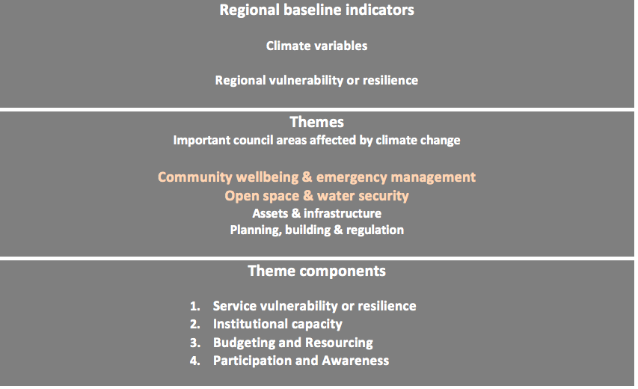
6. Draft framework
Notes:
Why we chose the two themes to focus on
Levels of indicators
- Importance of theme components (identified as important aspects of adaptation response – how adaptation happens inside council)
- Ensured we included both outcome and process level indicators (see next slide)

Slide 29
Principles guiding indicator choice
Adaptation implements processes or outcomes that:
Continue to perform under a number of different future scenarios.
Increase flexibility
Build in resilience and/or redundancy
Meet planned budgets
Don’t increase CO2-e
Don’t increase community vulnerability
Avoids adverse outcomes
Notes:
Principles that informed the choice of indicators. (developed overtime through workshops)

Slide 30
6. Piloting the Framework: Themes and Indicators (examples)
Regional Baselines: Indicators - providing important context
Regional Climate variables (temperature, rainfall, water supply etc)
Regional Vulnerability and Resilience:
  Regional heat vulnerability/canopy cover mapping
  Demographic vulnerability to heatwave impact by age
  Number of distributed heat related deaths and illness
  Demographic vulnerability to CC (socio-economic disadvantage; recent migrant distribution)
  Understanding community cohesiveness and support structures (surveys)
Notes:
Context setting

Slide 31

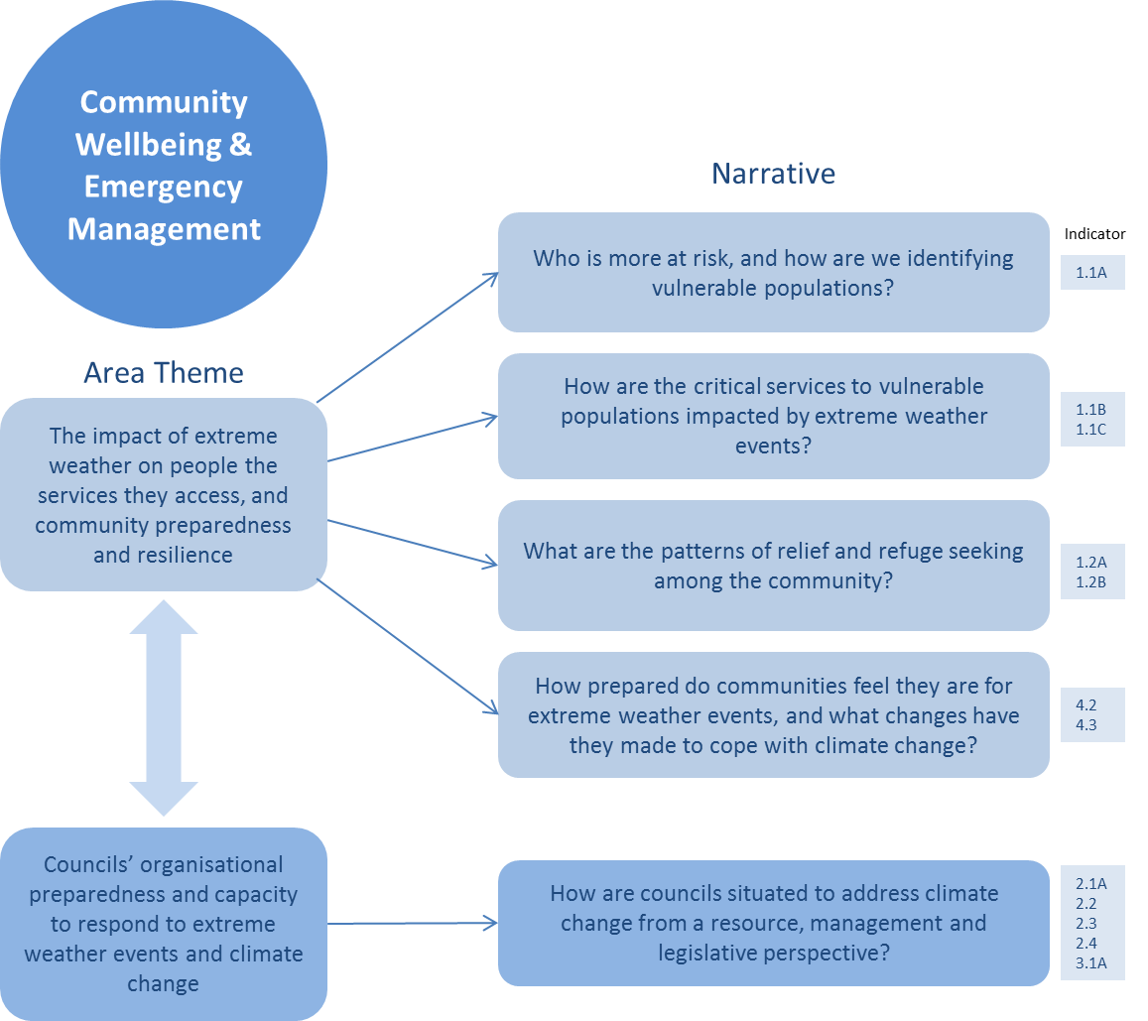
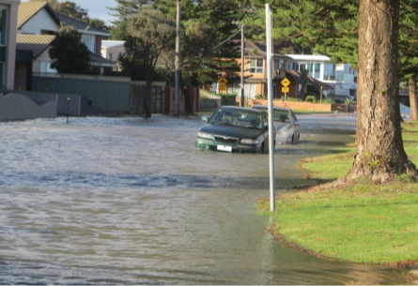
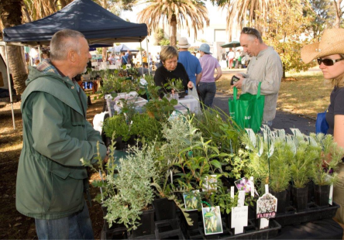
6. Piloting the Framework: Themes and Indicators Community Wellbeing and Emergency management

Slide 32
Community Wellbeing and Emergency Management: Indicators
Service Vulnerability and Resilience:
  Knowledge of vulnerable people exposed to extreme weather events
  Continuity of critical home and community care services
  Residents seeking refuge in official council run emergency relief centres during severe weather events
Institutional capacity:
  Staff capacity to address climate change in decision making (interviews and surveys)
  Emergency management framework recognises and responds to changing risk levels with climate change
Resourcing and Budgeting:
  Tracking long term trends in investment towards preparing for/responding to extreme weather events
Community Participation:
  Community preparedness to respond to extreme weather events
  Community lifestyle and household resilience to a changing climate

Slide 33
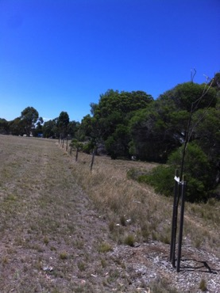
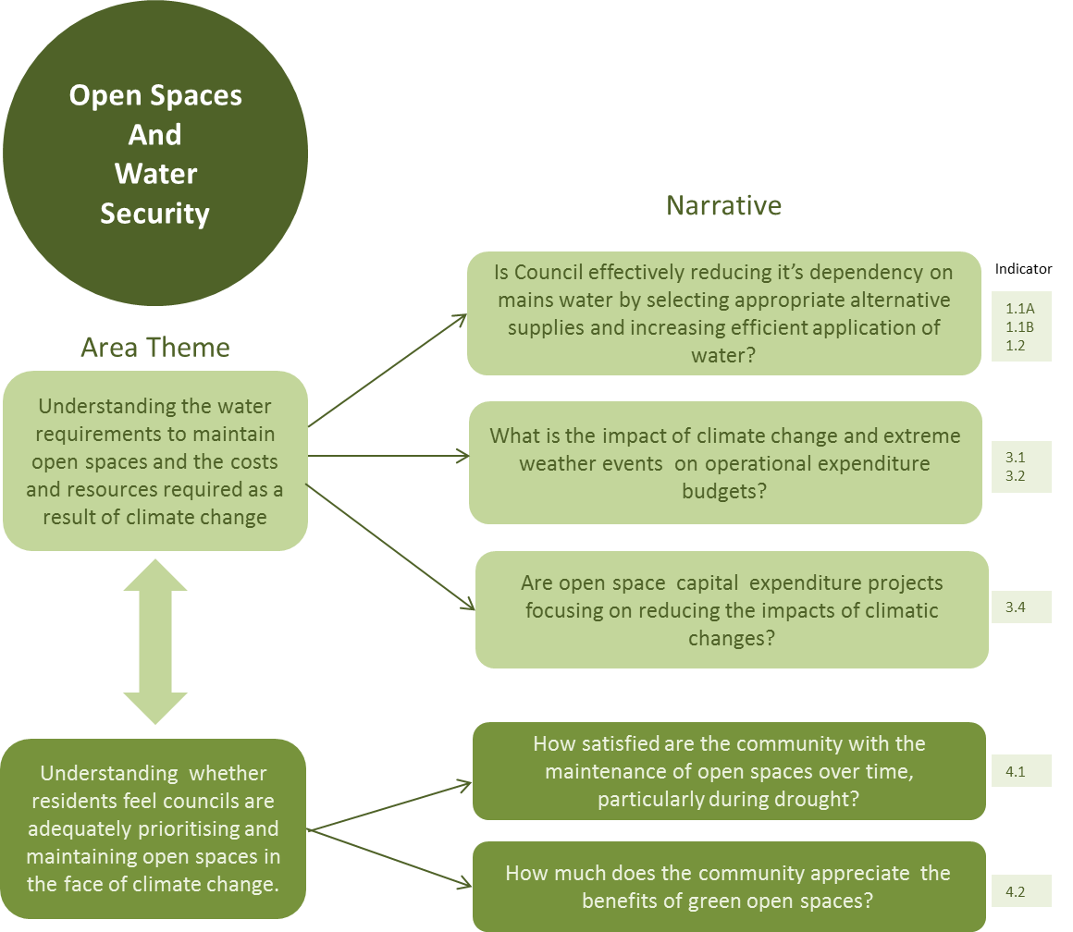
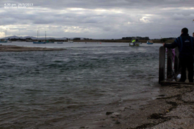
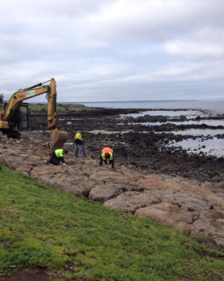
Open Space and Water Security

Slide 34
Open Space and Water Security: Indicators
Service Vulnerability/Resilience:
  Type and Volume of water supply used;
  variation of gap in water supply compared to demand over time;
  water efficiency
Institutional Capacity:
Resourcing:
  changes in long term trend in the cost and frequency of extreme weather event cleanups
  Understanding the impact of climate change on council’s operational budgets
Participation and Awareness:
  Understanding community satisfaction with open space over time

Slide 35
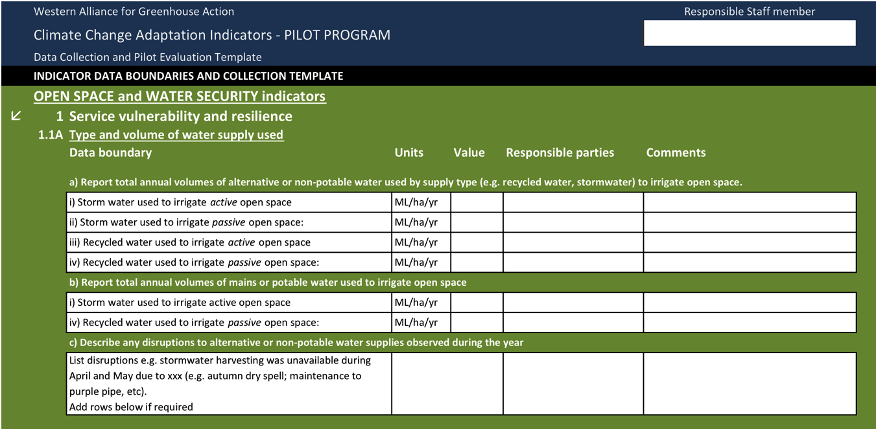
Data Collection – Indicator template
Piloting with four councils.
Notes:
Gives an idea of the amount of data we are attempting to collect for one indicator!

Slide 36
What could long term trending tell us?

Slide 37
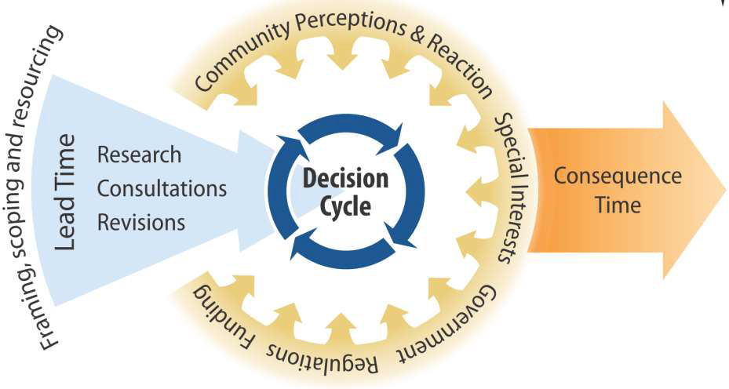
Value of the framework to inform decision making
Notes:
Pervasive impacts have built up gradually across our operations.
Local government decision makers are responding everyday.
It has been challenging to frame the problem and define a response.

Slide 38
Visualising long term trending
Notes:
Understanding the benefits of long term trending drives the commitment for this work
Needed to demonstrate long term changes on our service demand and delivery
Demonstrating changing demand with hard data provides evidence for business cases and budgets
We know that last year was drier than usual in Autumn and Winter, and that some councils had exceeded their water budgets by June because they had to extend their watering window. This has already started conversations around whether or not to water certain open space areas, and we are not technically in a drought.

Slide 39
What is this telling us and what do we want to know?
Notes:
Should be structured in a way that enables us to identify the cause of that change
e.g. more service cancelations
- due to client hospitalisations not Council service delivery.
There are also qualitative indicators that match quantitative indicators, so that we can capture exactly what issues are occurring. For example, we might observe that there is overcrowding in Leisure Centres on heat wave days and that life guards aren’t able to provide adequate supervision to pool users. A review of pool policy and education to community members who can’t swim well (such as recent migrants), but seek relief at pools during heat spells, may be necessary.

Slide 40
Emerging challenges
Time and resources
Data accessibility
Leadership and buy-in
Communicating value and relevance
Integrating in council operations and processes
Where to report? (Internal / external – relevant audiences)

Slide 41
Embedding M&E – key lessons
Embedding happens when the benefits are seen by the people generating the reporting (grounded in the day-to-day)
Embedding happens well when the framework is incorporated with council processes and thereby transcends staff turn-over.
Top down and bottom up process is needed.
Eventual goal is to break down internal barriers and create organisational change – shared responsibility for climate change.
Adaptation M & E – not one size fits all; local context/issues important.
Notes:
There is often a barrier in engaging staff on climate change adaptation because it can be perceived as an abstract concept that will happen sometime in the future, or perceived as being ‘someone else’s problem’. Evaluating and reporting on the indicators in this framework will encourage staff to shift their thinking away from the short term and doing what we’ve always done, towards evaluating how the decisions they make today will affect all of our collective futures, and can improve our resilience overtime.
Indicators can build an evidence base of the impacts and how well we are addressing them over time. In the normal routine of day-to-day decision-making there isn’t often a chance to step back and reflect on what is and isn’t working. This framework intends to act as a feedback mechanism to raise the level of organisational awareness and instil organisational learning and improvement that will push us in the right direction.

